Slide 1
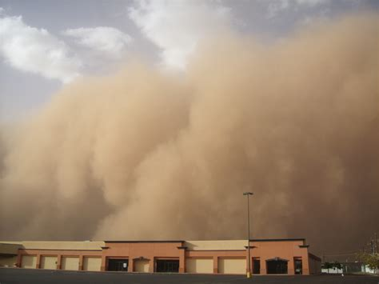

Pollution cause cards

Slide 2
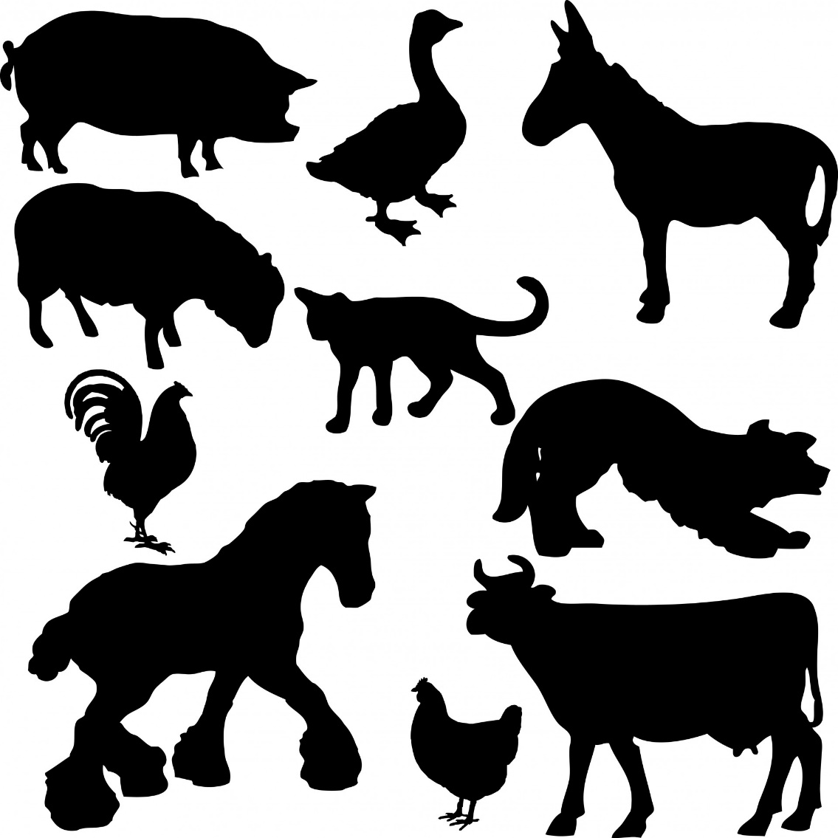
Pollution cause cards

Slide 3

Pollution cause cards

Slide 4

Pollution cause cards

Slide 5

Pollution cause cards

Slide 6


Pollution cause cards

Slide 7

Pollution cause cards

Slide 8

Pollution cause cards

Slide 9

Pollution cause cards

Slide 10

Pollution cause cards

Slide 11
Dust Storms | Farm animals
Cars | Industry
Aerosols | Farm machines

Slide 12
Airplanes | Fireworks
Lorries | Motorbikes

Slide 13

Pollution cause cards

Slide 14

Pollution cause cards

Slide 15
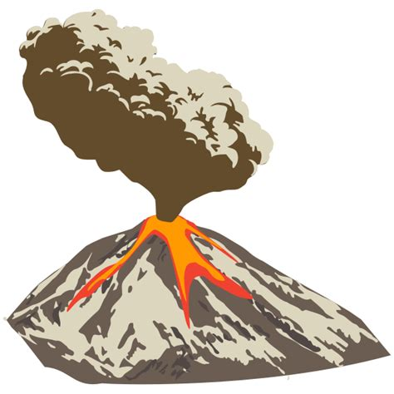
Pollution cause cards

Slide 16


Pollution cause cards

Slide 17

Pollution cause cards

Slide 18
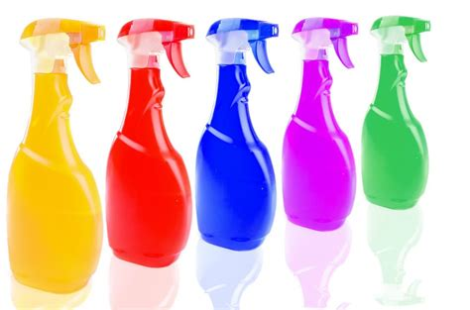
Pollution cause cards

Slide 19
Smoking | Forest Fires
Volcanoes | Construction
open fires | House-hold products

